Slide 1
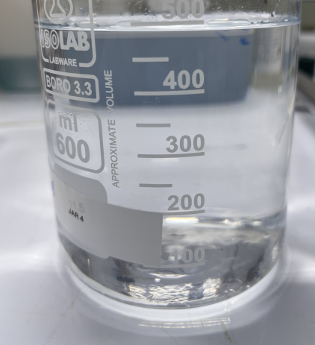
Date: 19-01-2022 | 21157_Micron HFW
Feed: 3L of EQ outlet (HFW feed) + Vitec 7400 added
1st process: 2-pass Flat sheet membrane operation
2nd process: RO reject to Jar testing
 | Micron HFW | Pass - 1 |  | Pass - 2
 | Feed | Permeate | Reject | Permeate | Reject
pH | 2.93 | 2.83 | 2.838 | 2.87 | 2.838
TDS (ppm) | 1296 | 451 | 1288 | 425 | 1358
EC (µs) | 2546 | 920.4 | 2527 | 850 | 2727
ORP (mV) | 474 | 453 | 364 | 400 | 358
NH4 |  |  | NA |  | NA
F- | 372 | 119 | NA | 126 | NA
SO4 | 363 | 334 | NA | 27.8 | NA
PO4 | 6.82 | <1 | NA | <1 | NA
Cl | 128 | 15.4 | NA | 13.5 | NA
Na |  |  | NA |  | NA
Ca |  |  | NA |  | NA
Si |  |  | NA |  | NA
Pass 2- Permeate
Volume (ml) | 3000 ml | 210 ml | 2790 ml | <100 ml | 2850 ml
Recovery | - | 7% | 93% | 3.5% | 96.5%

Slide 2
Jar testing Procedure
2 *400ml of RO reject is considered as Case 1 & Case 2
Case 1 – 4000mg of Ca(OH)2 in 400ml
Case 2 is 2400mg/l of Ca(OH)2 & 1600mg/l of CaCl2
Once dosed, allow rapid mixing for 30s, & followed by Slow mixing for 30 min, measure pH every 10 min
Dose 0.4mg/L of SNF polymer (anionic) for each jars and further slower mix (30 rpm) for 30 min. Measure pH every 20 min
Stop mixing and leave the solids to settle over 60 min, allow sludge settling
Measure turbidity of supernatant and collect the sludge
For the jar with the lowest supernatant turbidity reading, filter out the supernatant through 0.45um filter and send for analysis and collect the sludge generated
For the sludge collected, filter out using 1.5 μm filter. Collect the sludge, dry sample for XRD analysis.

Slide 3
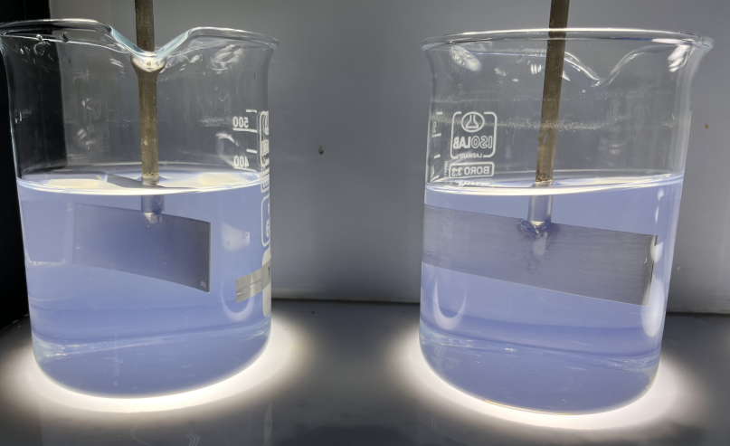
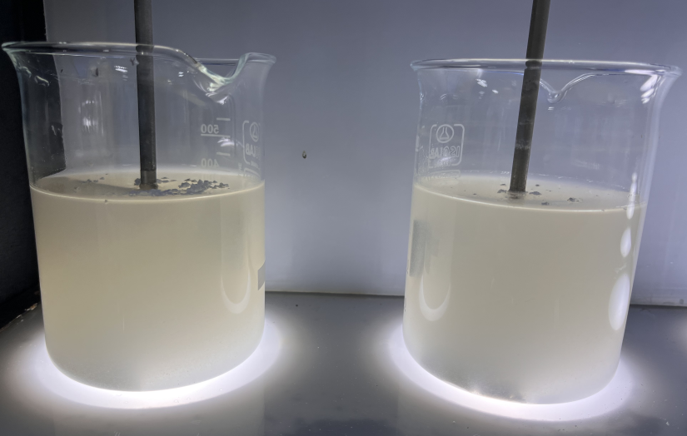
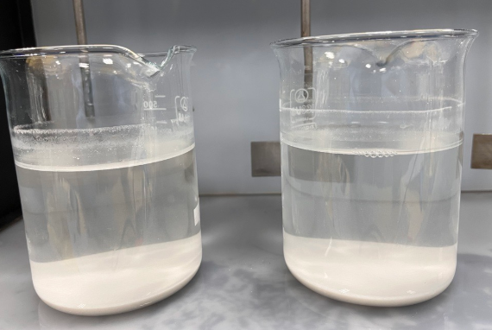
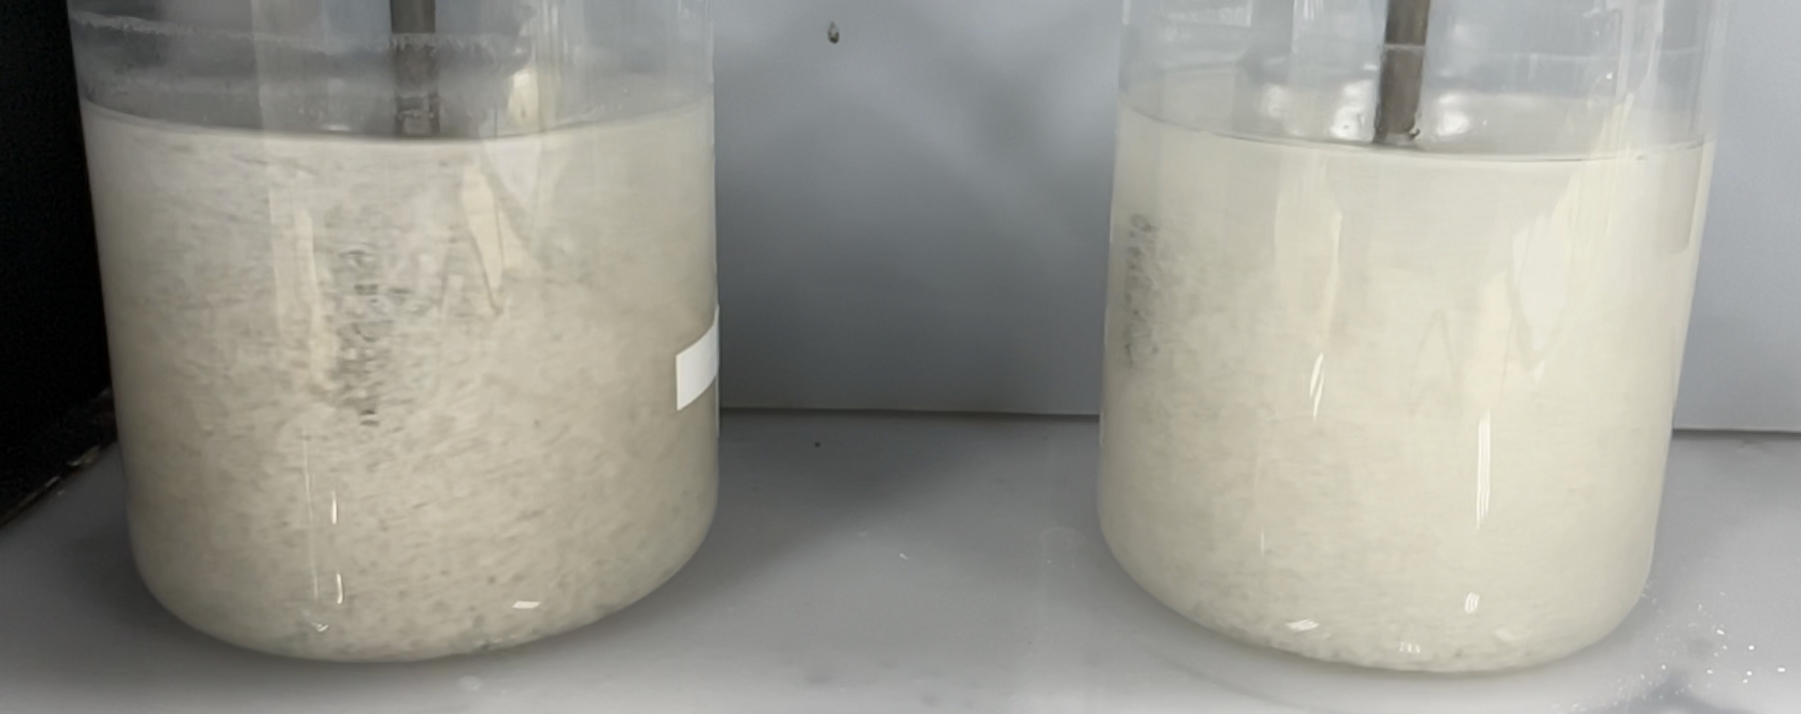
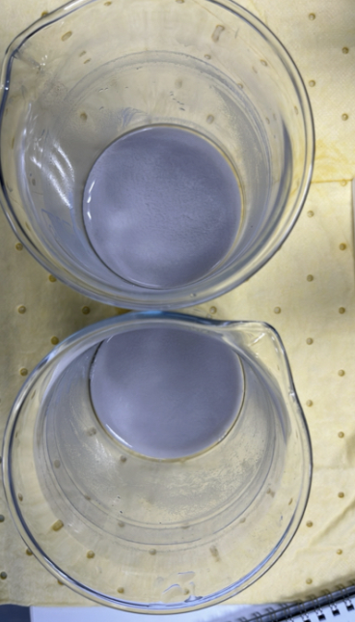
Jar Testing Procedure
RO reject as New feed
Case 1:
4000mg of Ca(OH)2 in 400ml RO reject
Case 2:
2400mg of Ca(OH)2
& 1600mg of CaCl2
in 400ml RO reject
Dose 0.4mg/L of SNF polymer (anionic)
Settling process
Supernatant water (for discharge)
Sludge for disposal

Slide 4
Jar Testing Results
 | Case 1 1000mg/l Ca(OH)2 | Case 2 6000mg/l Ca(OH)2+ 4000mg/l CaCl2
pH | 12.43 | 7.2
TDS (ppt) | 110 | 7354 ppm
EC | 2546 uS | 13.16 mS
ORP (mV) | 83 | 57
NH4
F- | 9.45 | 7.63
SO4 | 343 | 348
PO4 | <1 | <1
Cl | 61.03 | 1917
Na
Ca
Si

